Slide 1
Greetings,

Slide 2
Greetings,

Slide 3

Greetings,
ROGER ARTHUR WILLIAM A. DE GUZMAN
CEO of

Slide 4
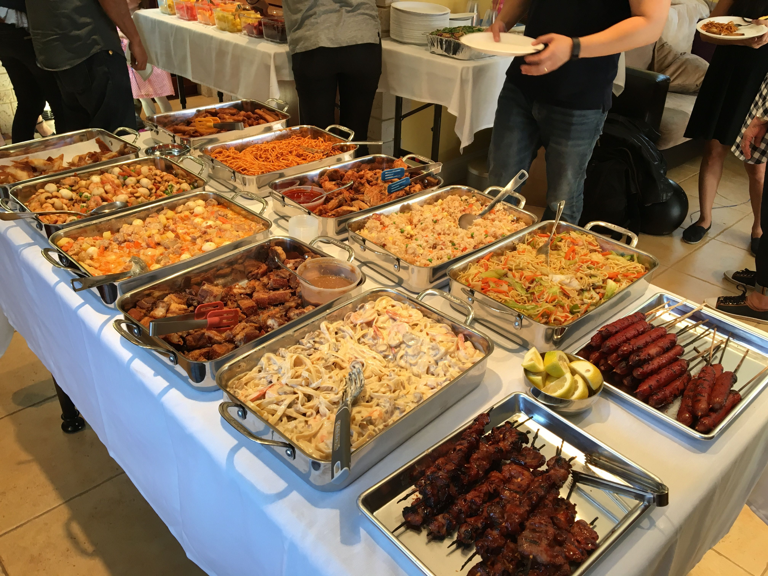
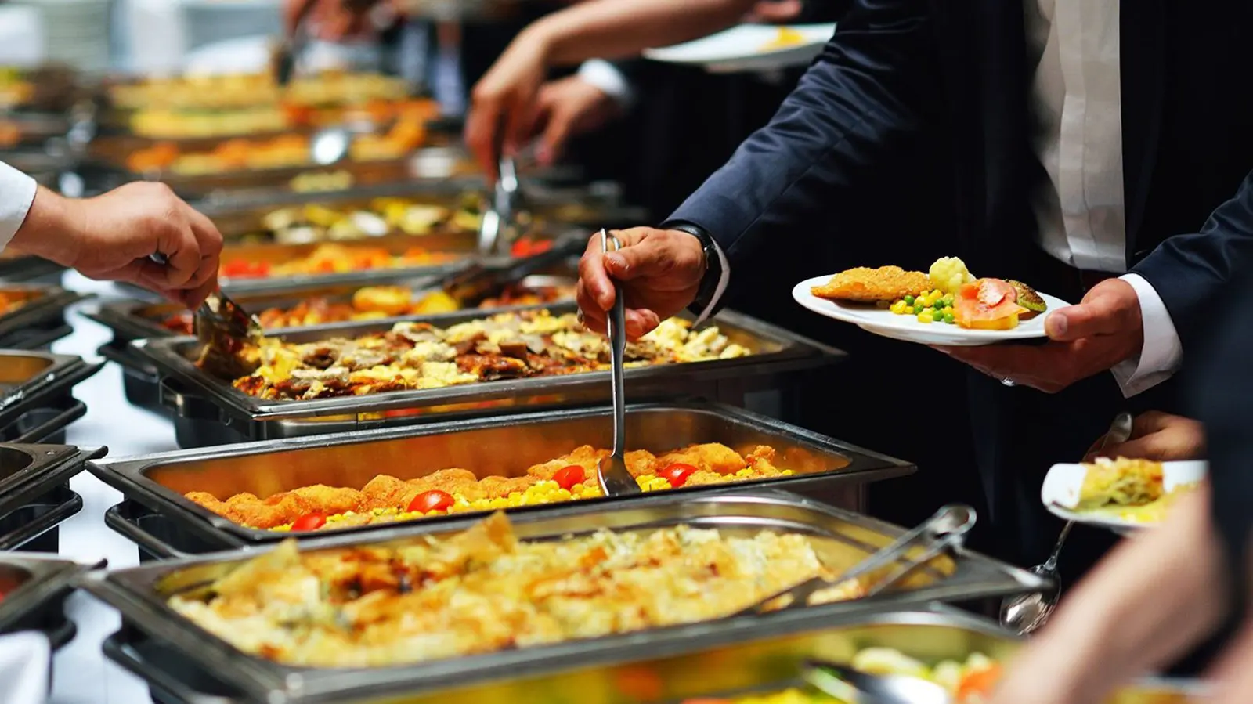
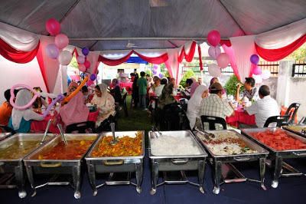
FOOD CATERING SERVICES
IN THE PHILIPPINES
Filipinos always love parties!

Slide 5


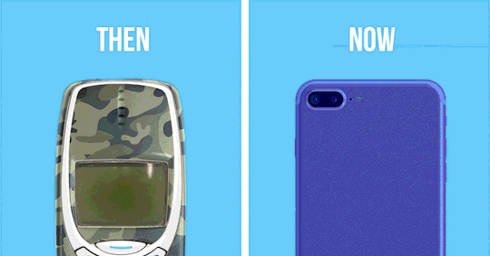
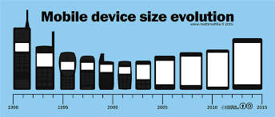
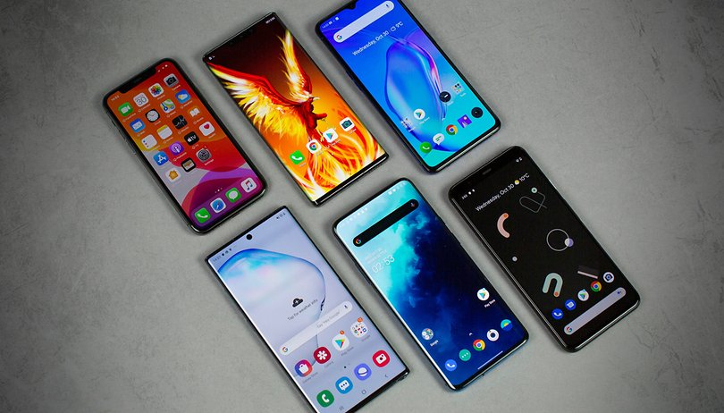
MOBILE APPLICATIONS
BECAME VERY POPULAR EVER SINCE 2013

Slide 6





FOOD DELIVERING APPLICATIONS
BECAME VERY POPULAR EVER SINCE PANDEMIC

Slide 7
What are the problems we are trying to solve for food catering services?
Lack of effective digital marketing for food catering services.
Absence of a platform specifically designed for transactions involving food catering services.

Slide 8


FACEBOOK
INSTAGRAM
GENERALIZED
MARKETING FUNCTIONS

Slide 9

E-Cater Mo!

Slide 10
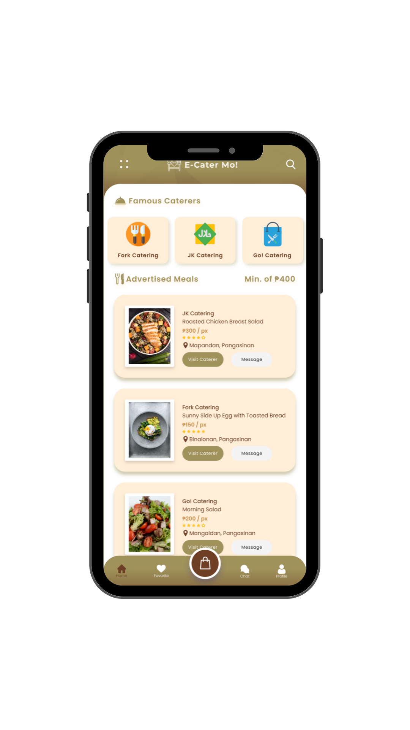

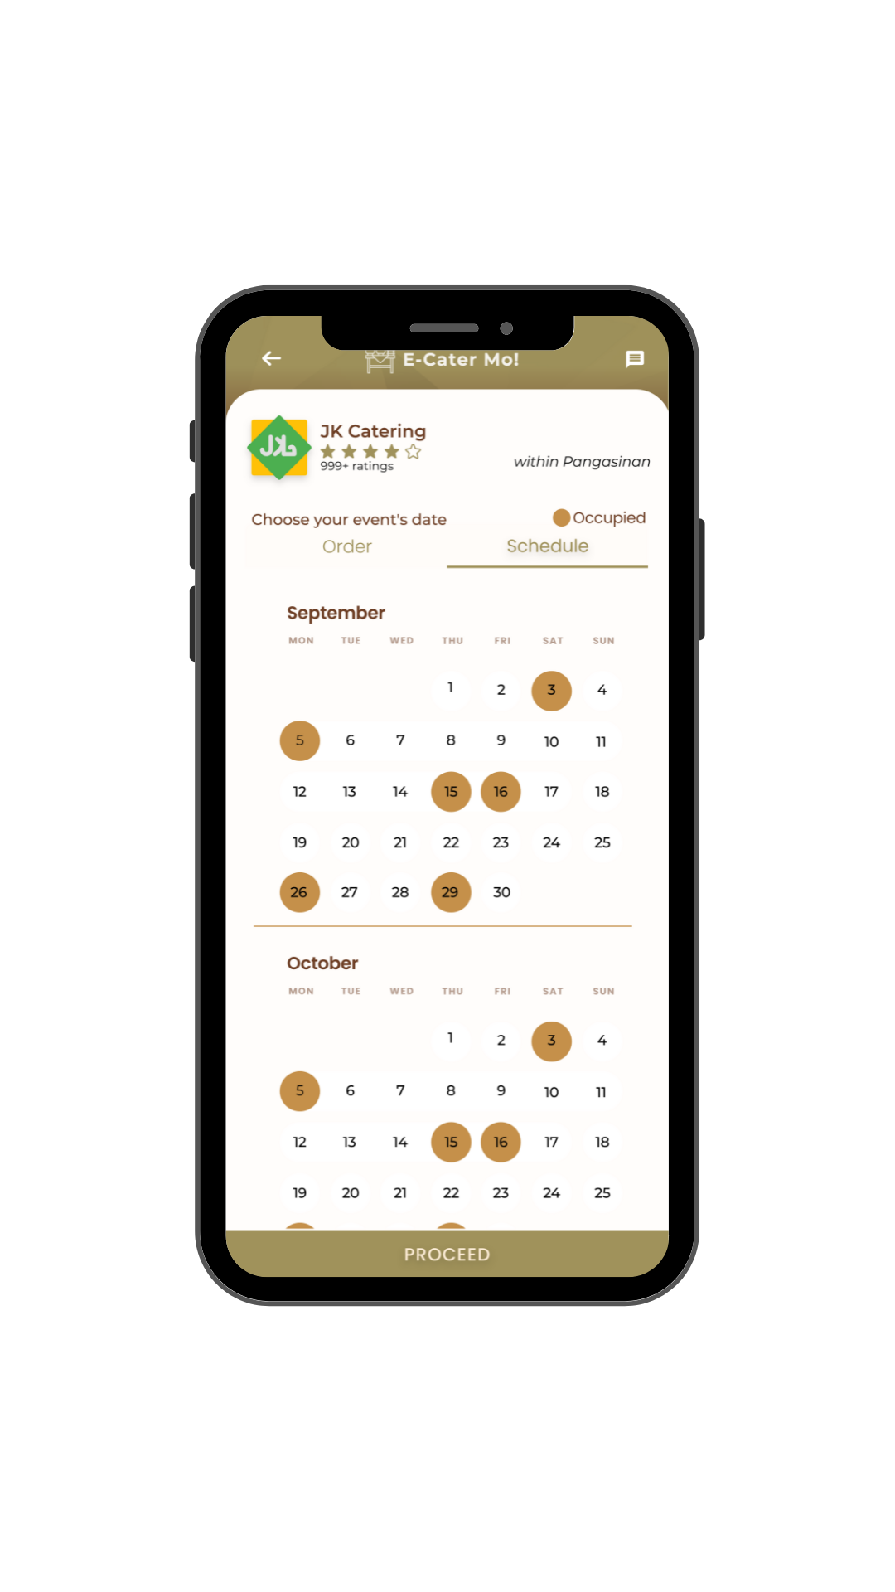
E-CATER MO

Slide 11
MAIN FEATURES

Slide 12
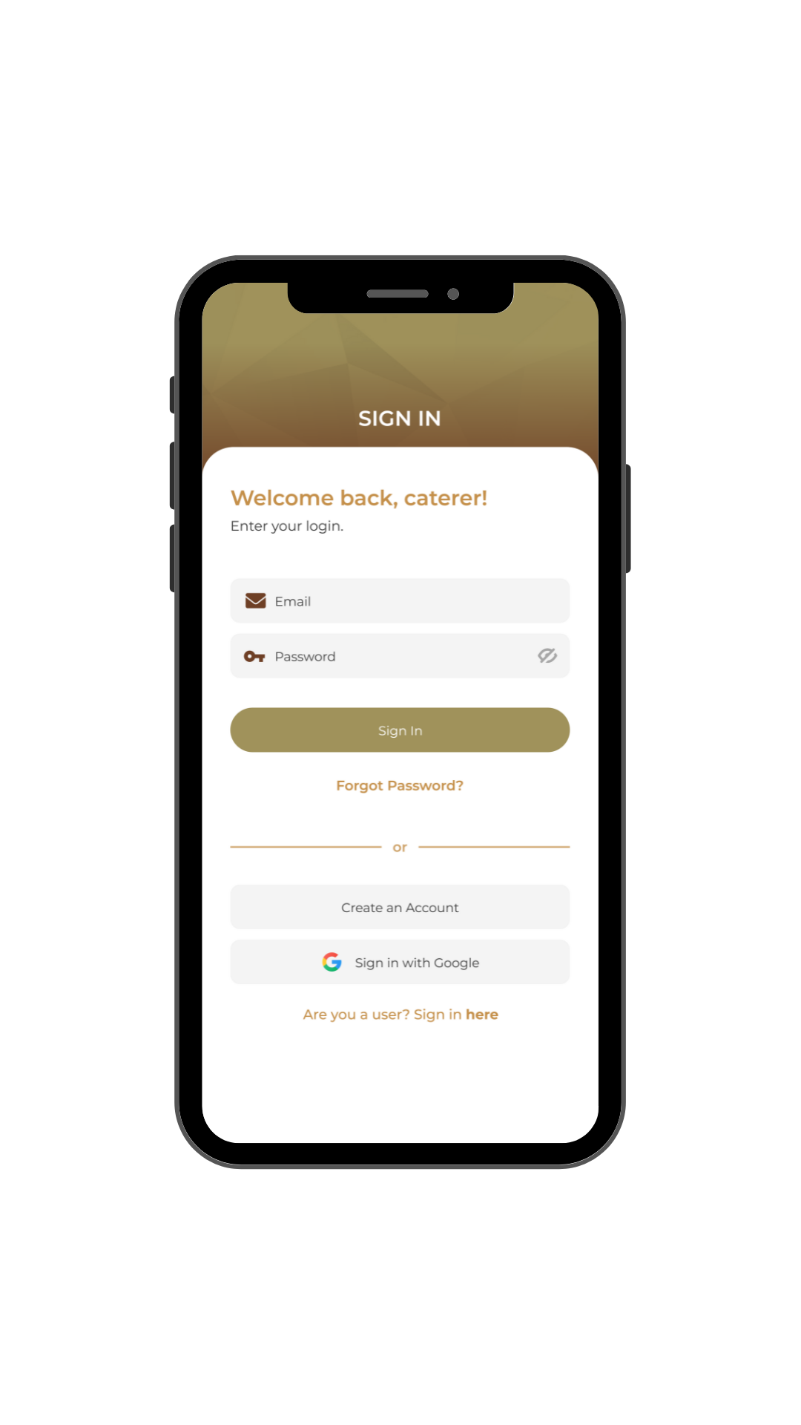
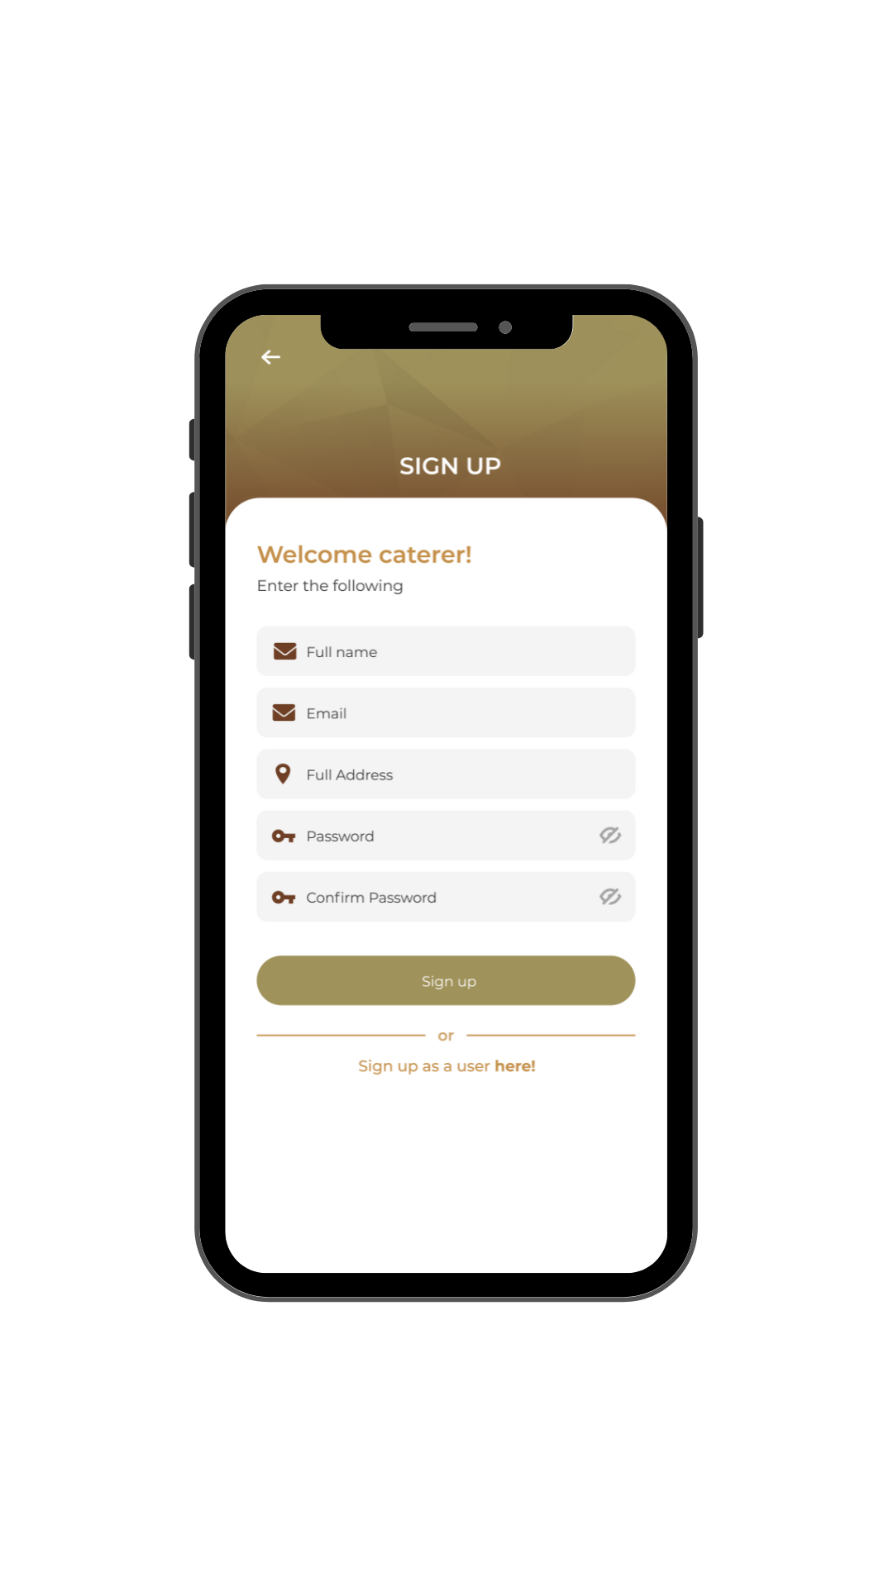
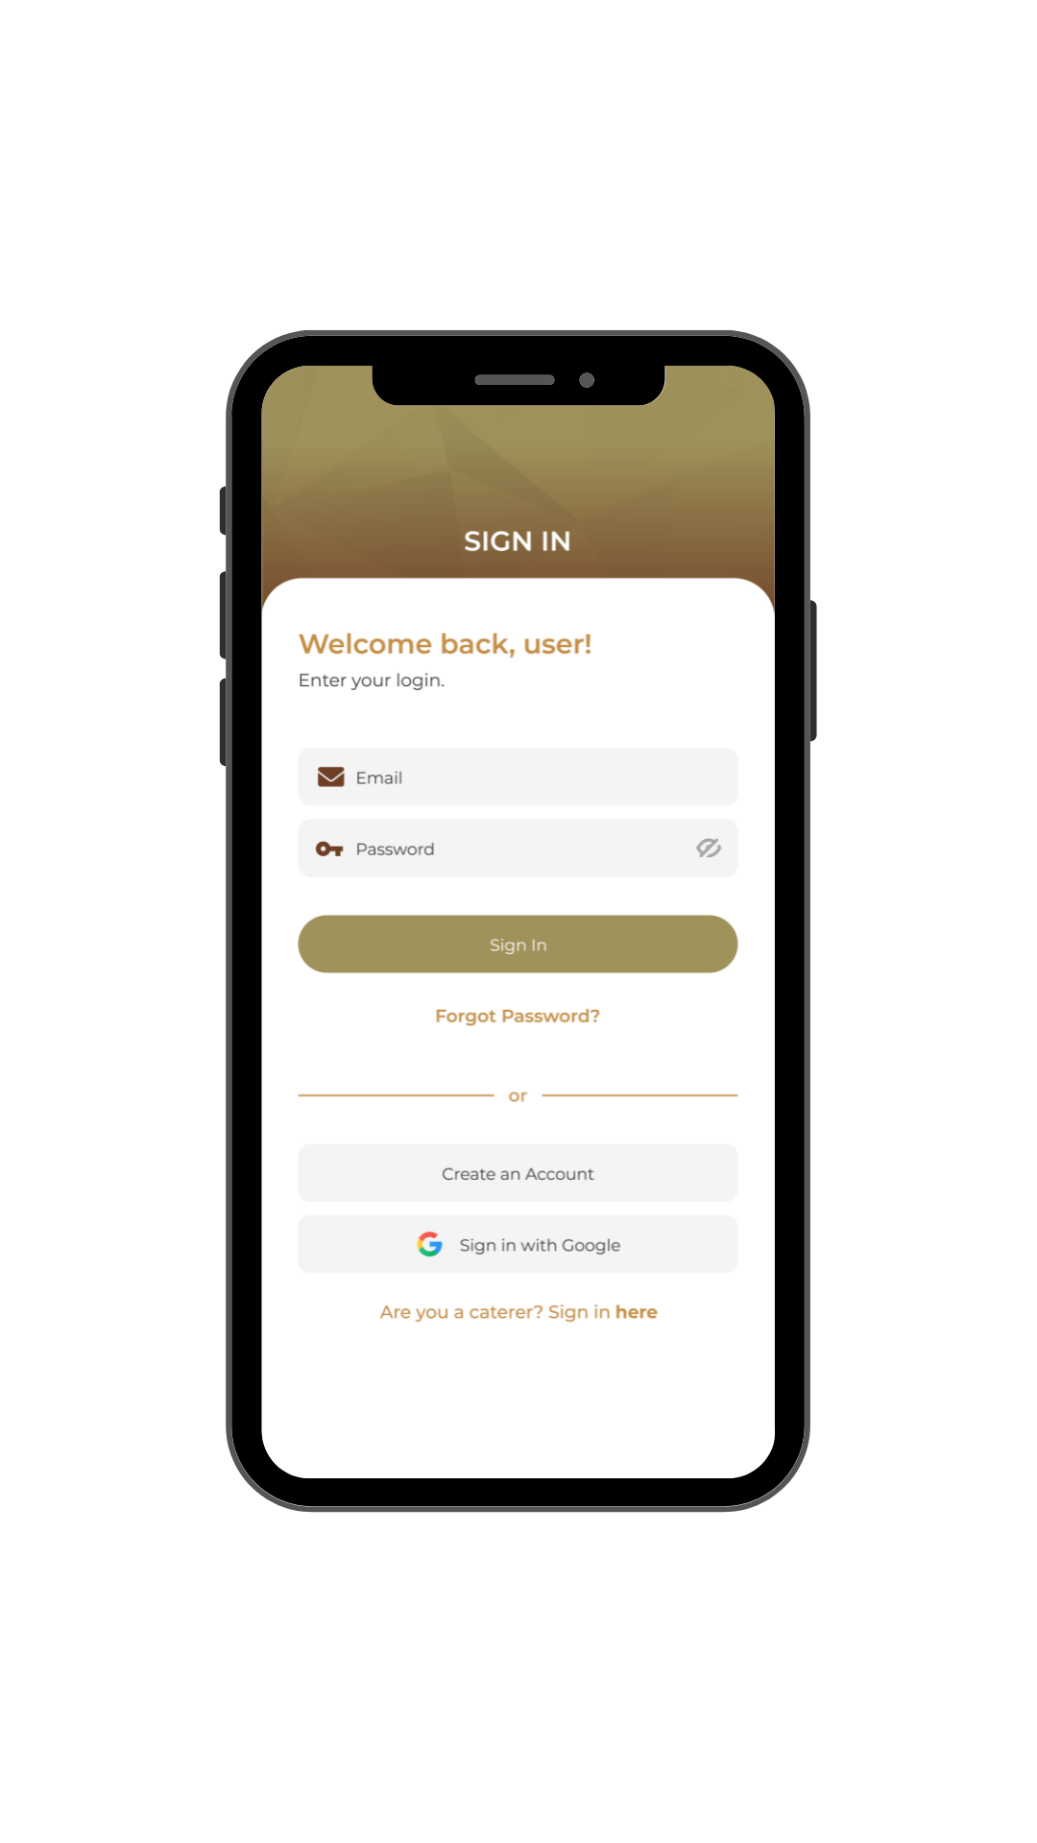
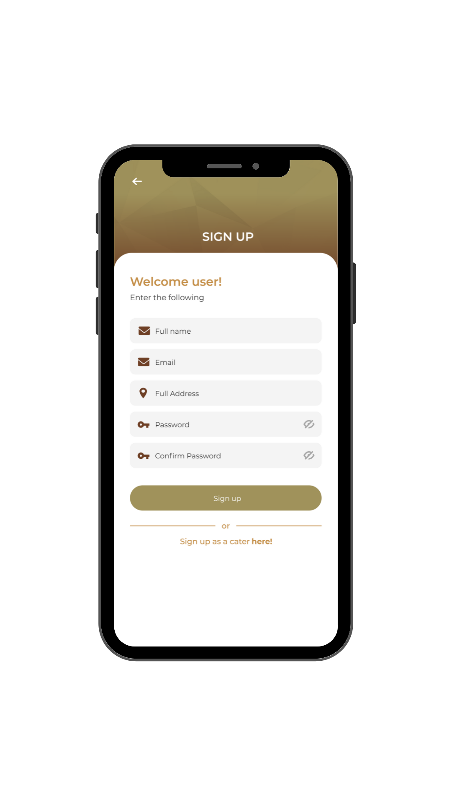
Specialized Log in UI
USER
CATERER

Slide 13
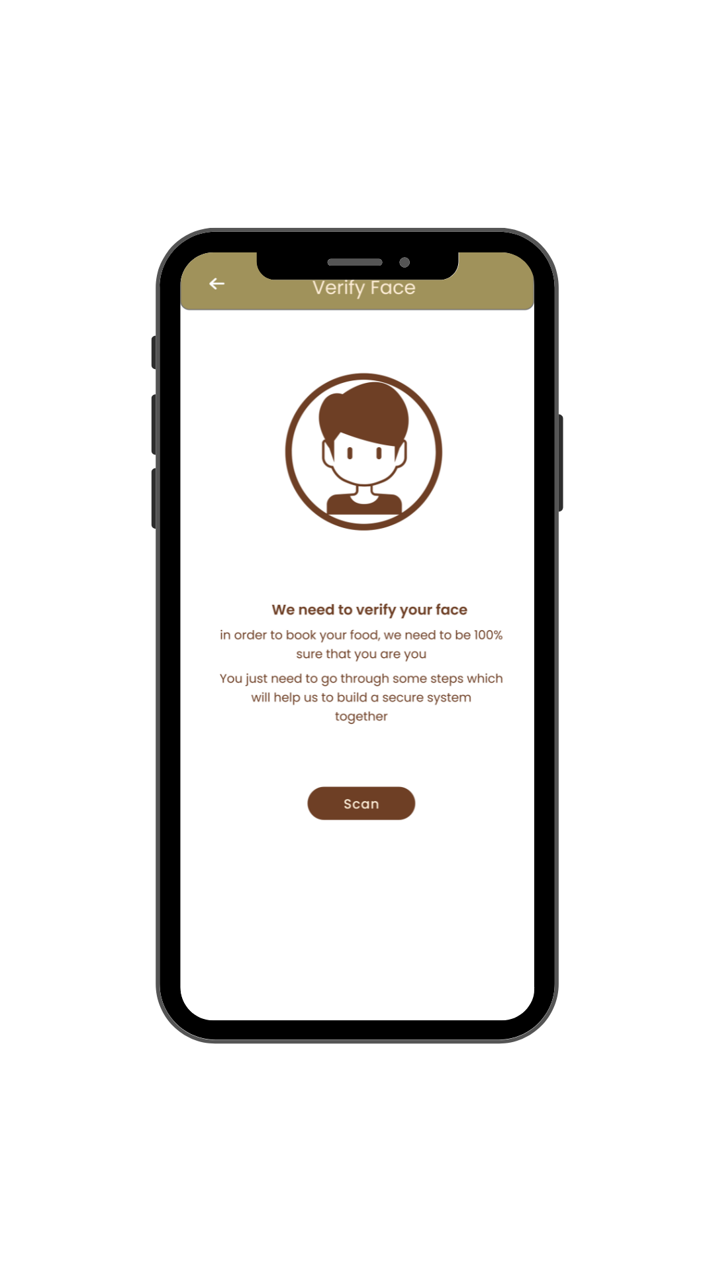
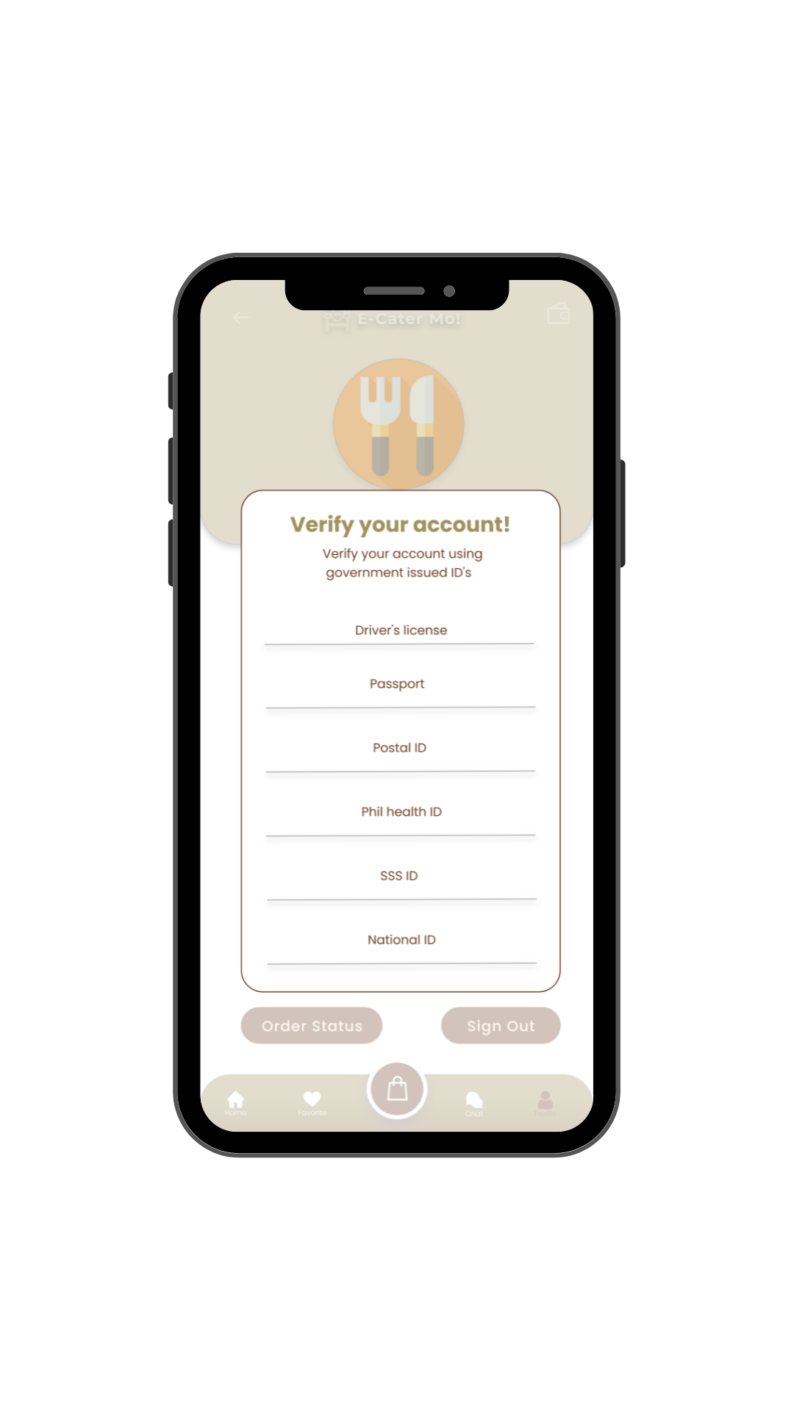
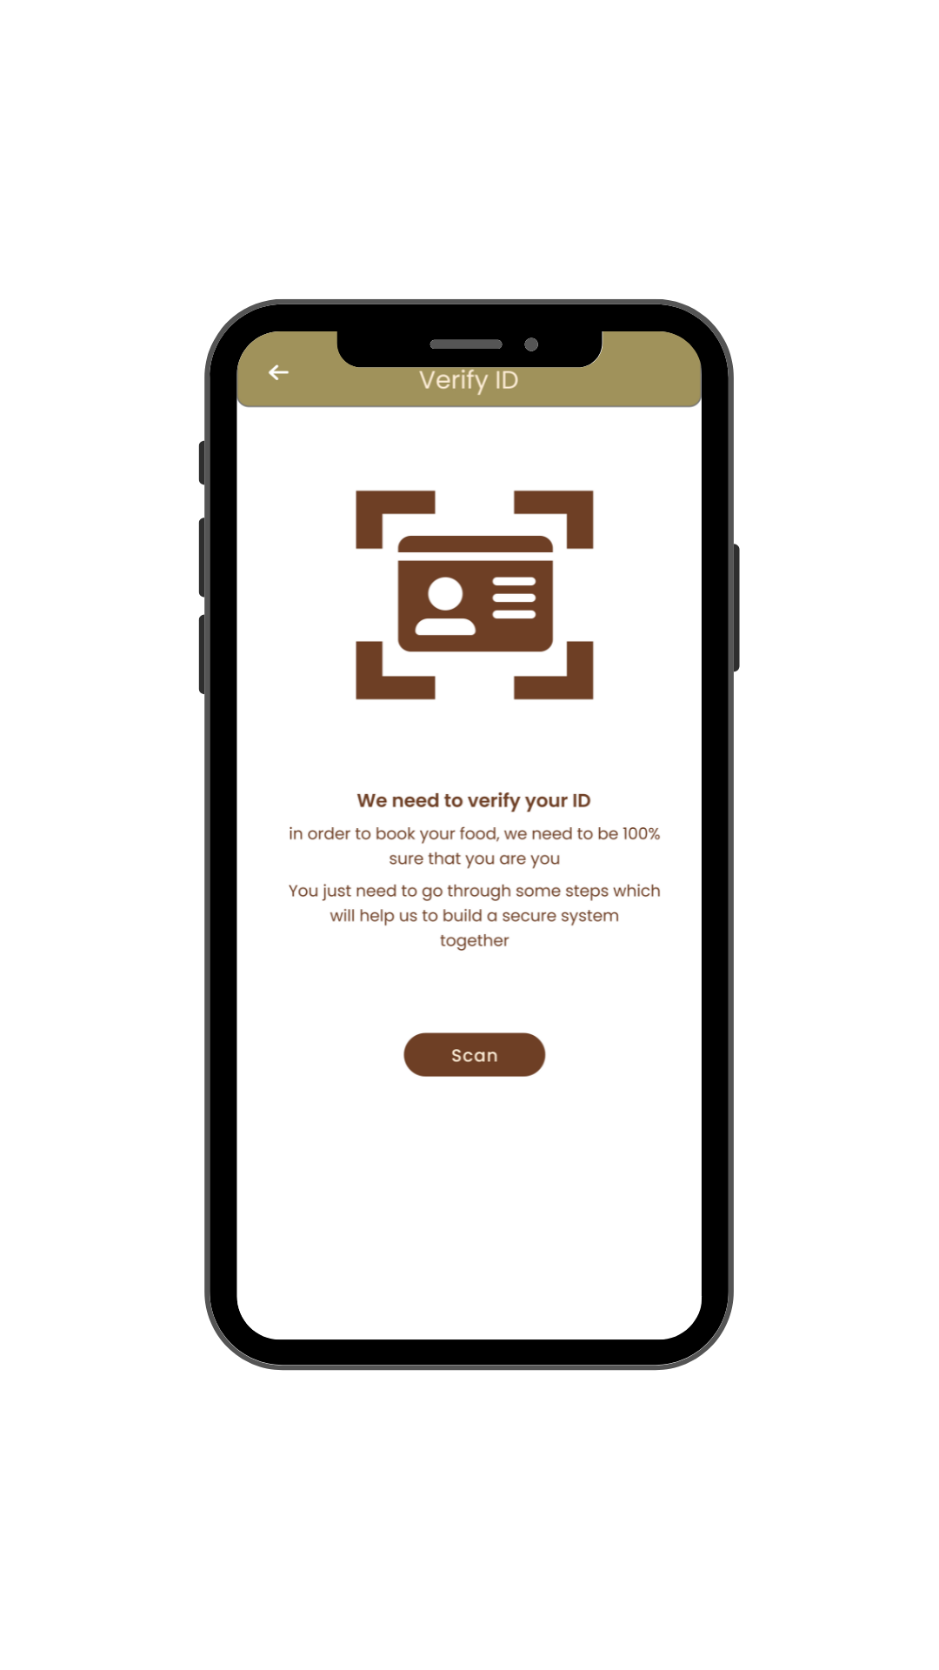
Verification
AI FACIAL RECOGNITION
SUBMITTING A
GOVERNMENT ISSUED ID

Slide 14

Home Screen
Both User and Caterer
USER
CATERER

Slide 15
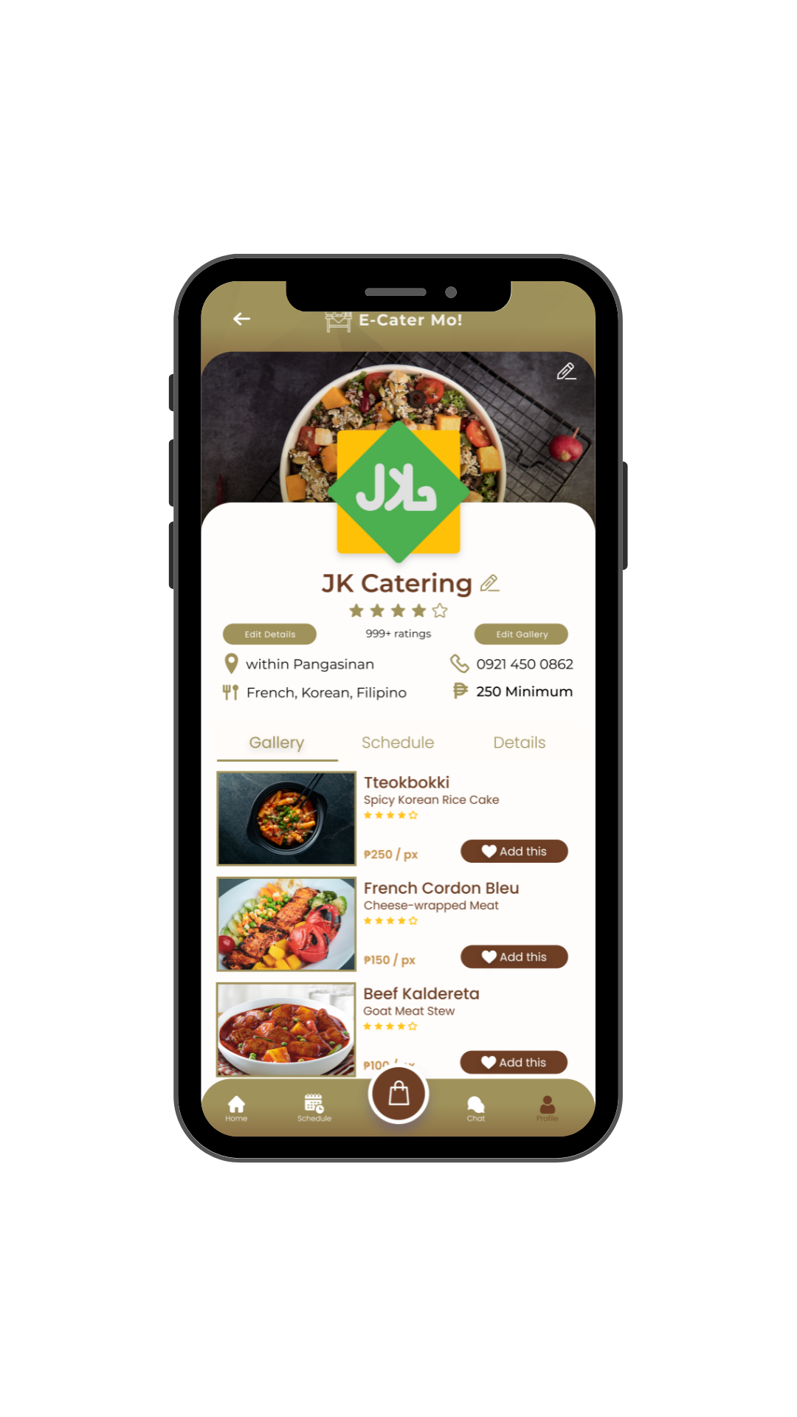
Caterers Can Showcase Food

Slide 16
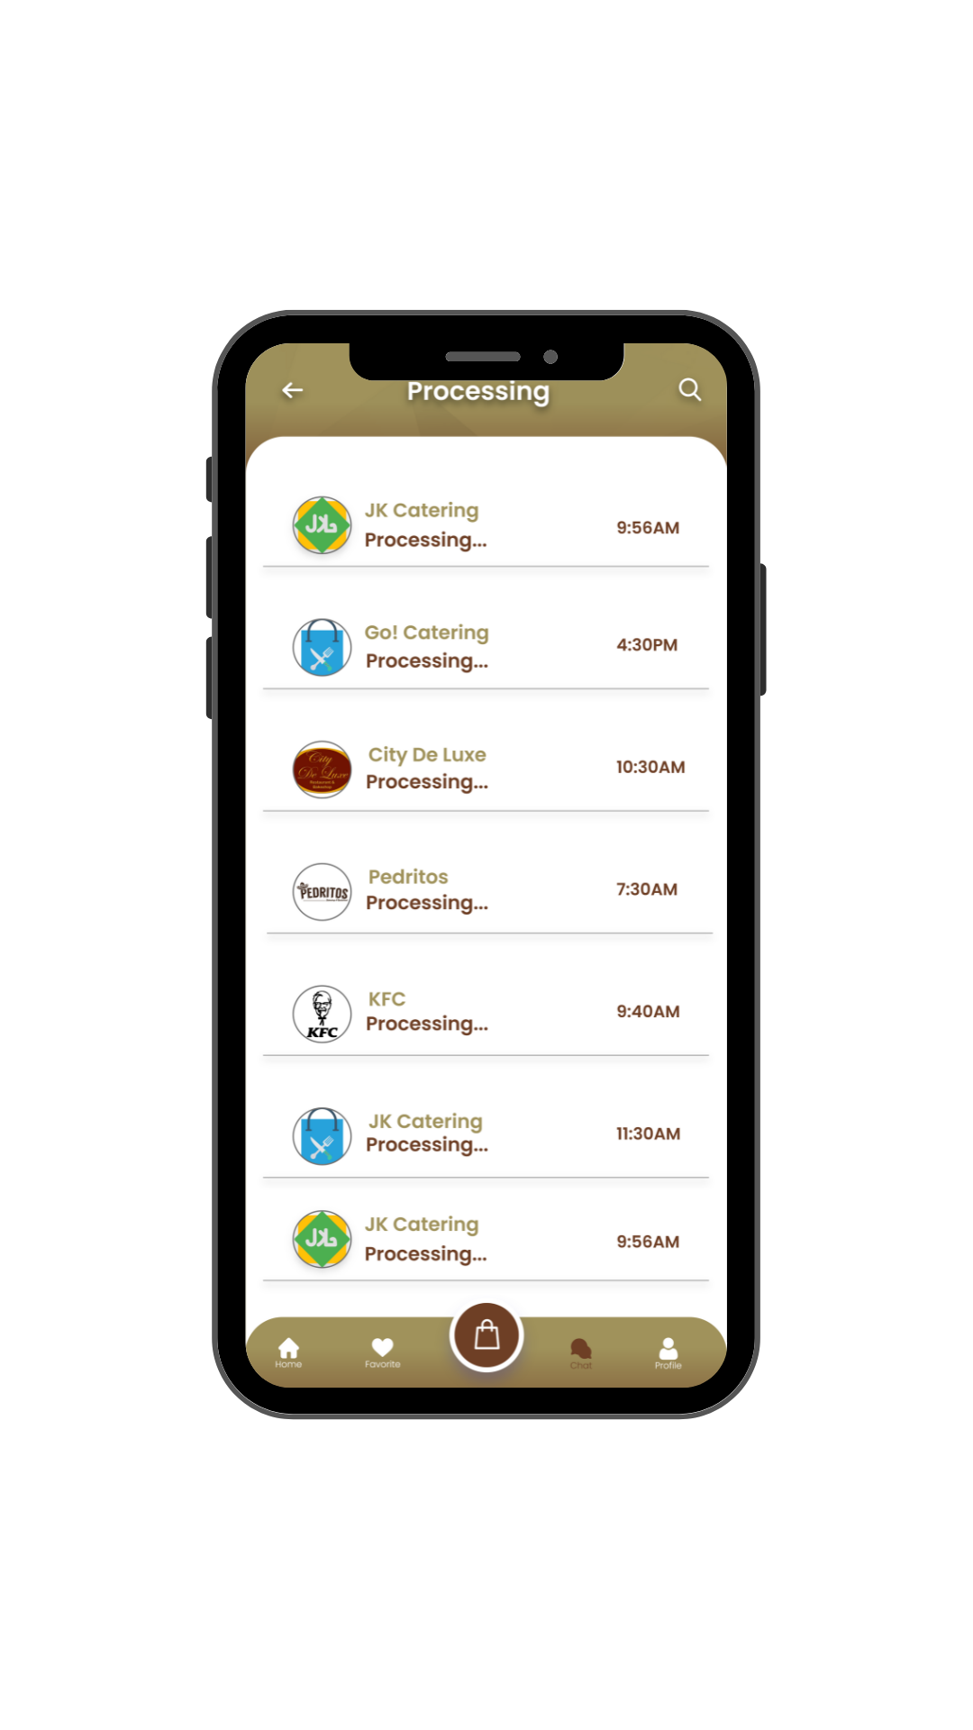
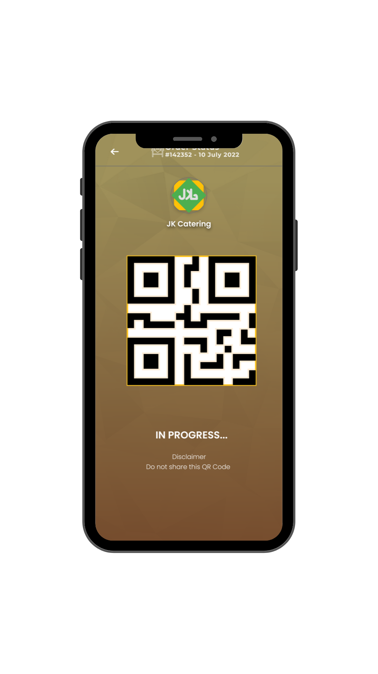
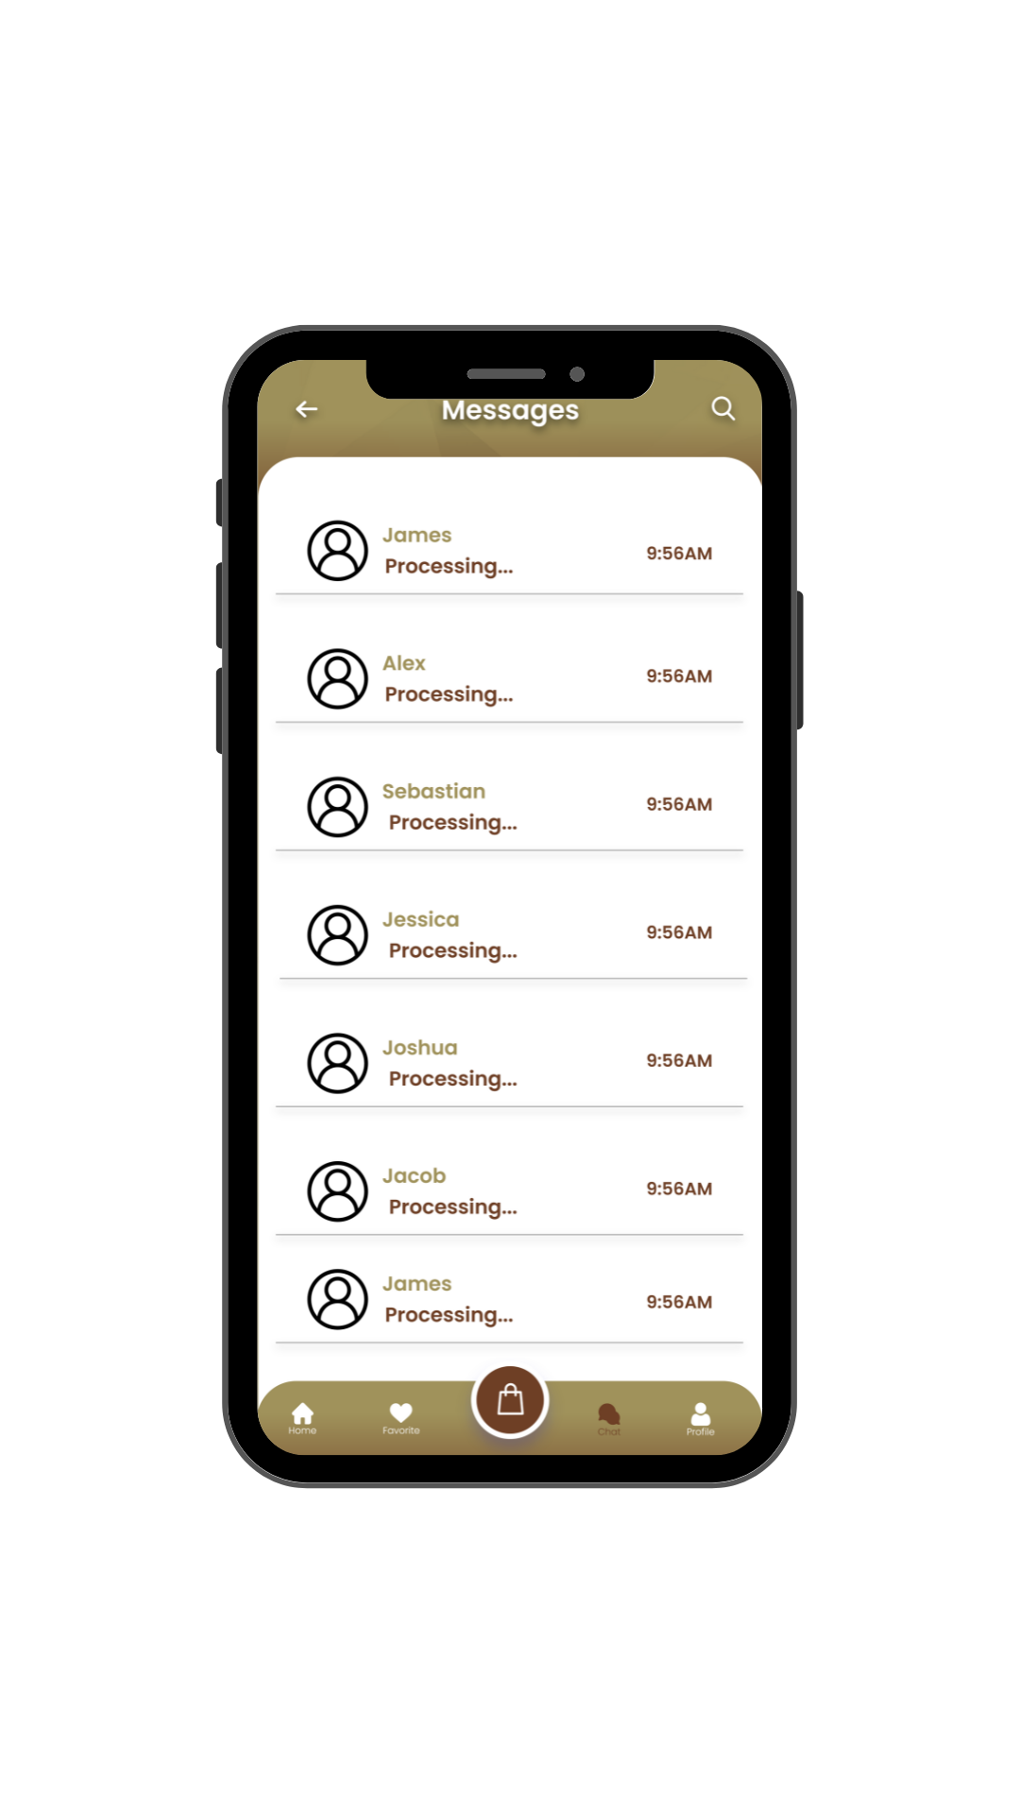
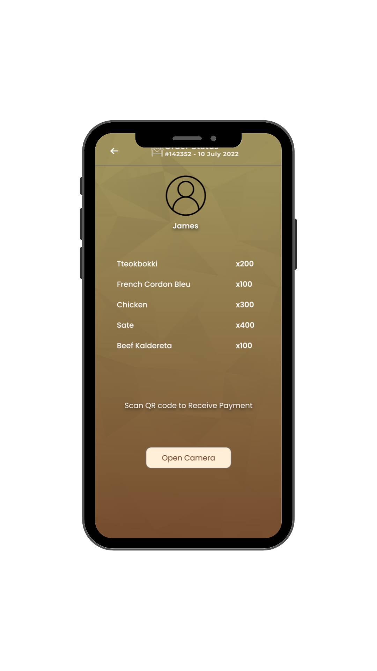
Security of Every Successful Transaction
USER
CATERER

Slide 17
THE FOUR Ps OF
MARKETING A NEW VENTURE

Slide 18
PRODUCT
(TANGIBLE/ INTANGIBLE/ SERVICES)
Mobile Development
● Android
● Database
● IOS (for the future progress development)
● Xamarin (for app developing)
● Adobe XD (for designing and prototyping)
● Adobe Photoshop
Website Development
● Sublime Text
● Bootstrap
● Adobe XD (for designing and prototyping)
● Adobe Photoshop

Slide 19
PRICE
Since we are developing a mobile application software, we will earn through commissions from the caterers and to the clients. The following are the commissions that we will earn from:
Monthly-based (Target sales per month = Php 150,000)
Commission Fee for Customers’ Transaction – we will charge a fee to end users for around 5% every successful transaction (Ex. Total Contract Price x 5%)
Monthly Membership Fee for Caterers – catering businesses are allowed to display their services with advertisement on our platform. (Ex. 1 caterer (client) = Php 500)
E-Wallet – this will charge 5% per conversion (Optional)

Slide 20
PROMOTION
Embed, our online catering service, is available. That might be of great assistance to many prospective clients who want hassle-free catering services. Our main goal here is to make all of the caterers and customers have a great deal with each other, helping to promote other catering services and customers don’t need to go to the shops that they want at the same time. There are 3 ways to promote our system, and these are Advertising, Public-Relations and Social Media.

Slide 21
PLACE
We settled on an online marketplace. By doing so, we can reduce barriers to buying and give customers as much convenience as possible. Nowadays, purchasing or selling goods online is considerably preferable to remaining stationary. Reaching as many clients as possible at the correct moment will enhance sales and the profitability of the company. E-commerce involves the purchasing and selling of items as well as sending money or data through the internet.

Slide 22
TARGET CUSTOMERS
Specifically for the citizens of the Philippines
Those that use the program to look for suitable caterers—also known as the users— for their occasions.
Customers who will use the platforms for advertising the products—also known as the food caterers—in order to purchase our service.

Slide 23
THE ECONOMICS OF BUSINESS:
COST OF SALES
Annual Website Maintenance Fee | Amount
Domain Name | Php 1,000.00
Web Hosting | Php 9,000.00
SSL Certificate | Php 57,000.00
Total Website Maintenance Fee | Php 67,000.00

Slide 24
Annual Mobile Maintenance Fee | Amount
Servers | Php 24,000.00
Push Notifications | Php 5,000.00
Database | Php 20,000.00
Payment Gateways | Php 68,000.00
Total Mobile Maintenance Fees | Php 117,000.00

Slide 25
Wages of laborers and programmers | Amount
Website Developers | Php 138,000.00
Mobile Application Developers | Php 276,000.00
Tech Support | Php 120,000.00
Total Wages of laborers & programmers | Php 534,000.00

Slide 26
FIXED OPERATING EXPENSES
Fixed Operating Expenses | Amount
Advertising Expense | Php 15,000.00
Social Media Advertisements | Php 3,400.00
Help Desk Salaries | Php 180,000.00

Slide 27
FIXED OPERATING EXPENSES
Admin Salaries | Php 300,000.00
Electricity | Php 180,000.00
Landline/Internet | Php 20,000.00
Total Fixed Operating Expenses | Php 698,400.00

Slide 28
FINANCIAL PROJECTIONS
Pro Forma Income Statement (Annual) |  |  | Growth % | 2023 | 2024 | 2025 | 2026 | 2027
Target Sales* |  | 1,611,708.00 | 3% | 1,660,059.24 | 1,709,861.02 | 1,761,156.85 | 1,813,991.55 | 1,868,411.30
Cost of Sales |  | (718,000.00) | 3% | (739,540.00) | (761,726.20) | (784,577.99) | (808,115.33) | (832,358.79)
Gross Profit |  | 893,708.00 |  | 920,519.24 | 948,134.82 | 976,578.86 | 1,005,876.23 | 1,036,052.51
Less: Operating Expenses (fixed) |  | 636,960.00 | fx
 | Electricity*** | (180,000.00) | 0.25 | (155,303.40) | (159,962.50) | (164,761.38) | (169,704.22) | (174,795.34)
Operating Income |  | 76,748.00 |  | 143,255.84 | 166,212.32 | 189,857.48 | 214,212.01 | 239,297.17

Slide 29
TARGET SALES
Our target sales for our first year is set to be ₱ 1,765,204.00. We divided our service income.
Monthly-based (₱ 1,765,204.00 / 12 = ₱ 141,100 round off to ₱ 150,000)
Target sales for Commission Fee is ₱ 100,000
Breakdown: Total Contract Price Target is ₱ 2,000,000 x 5% = ₱ 100,000
Conclusion: If per plate is average ₱400, we need to have 5,000 pax.
Target sales for Monthly Membership Fee for Caterers is ₱ 50,000
Breakdown: 100 caterers x ₱500 = ₱50,000
Conclusion: We need to maintain 100 caterers in using our platform every month.

Slide 30
Assumptions
The company aims to set sales to grow at 3% per year. The company have no plans increasing fixed operating costs within the 5-year financial projections
Target Sales is set to be 15% above total costs
Depreciation expense derives from Equipment totalling P360,000.00 with 5 useful years
Electricity is proportionate to the level of activity for the period, thus garnering a growth as the cost of sales increase

Slide 31
THANK YOU FOR YOUR PARTICIPATION

